Slide 1

Problem Statement 2- Identification of User Query on Stack Overflow Using Semantic Search
Saurabh Singh(Frontend and Backend Engineer)
Priyanshu Sinha(NLP engineer)

Slide 2
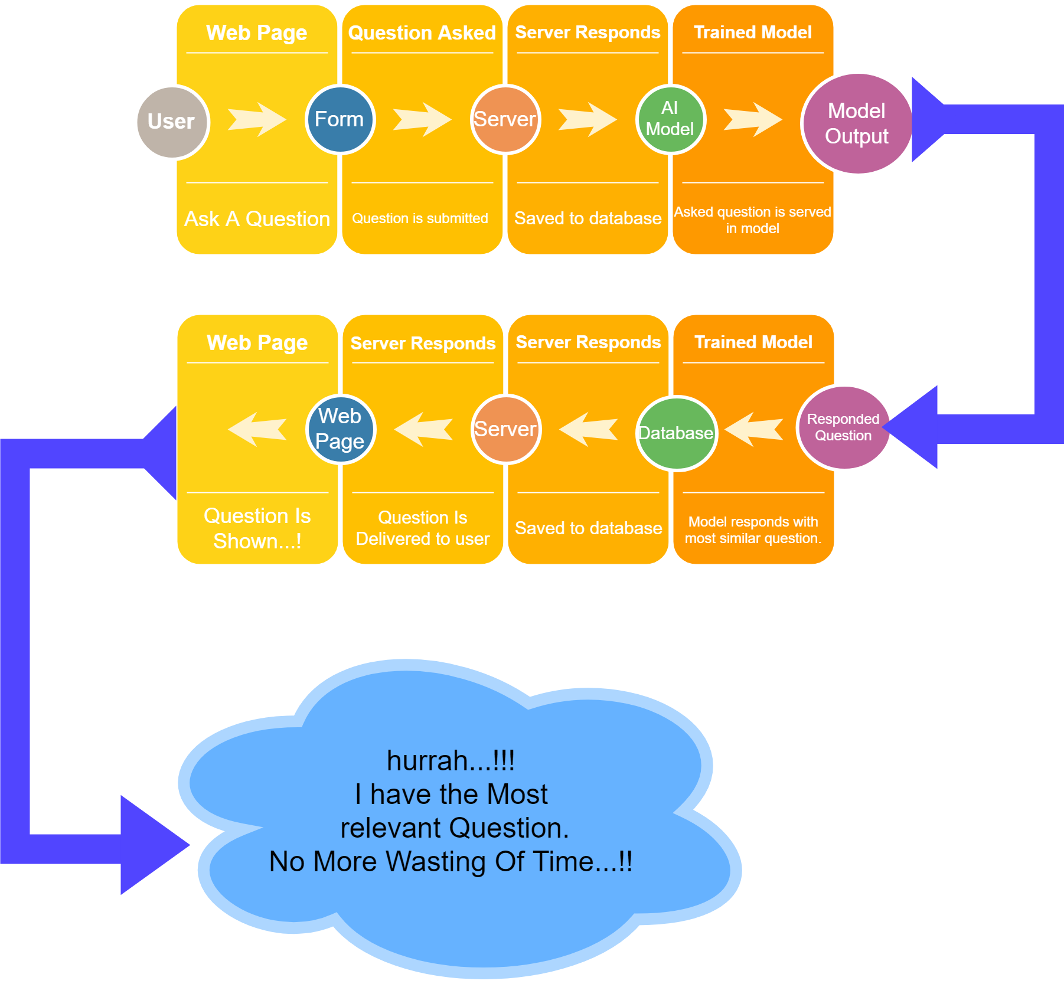
The flow of program

Slide 3
The AI model behind.
AUTO TAGGER USES LSTM LAYERS AS IT’S WORKING CELL AND HENCE IS TRAINED ON ONLY 2000 QUERIES PER TAG FOR MULTI CLASS CLASSIFICATION
AI Model
Auto-Question Tagger/
Auto-Tagger
Semantic similarity
SEMANTIC SIMILARITY IS THE FINAL STEP WHICH IDENTIFIES THE SIMILAR QUESTIONS ASKED BY USER.THIS PART OF OUR MODEL USES THE GLOVE MODEL BY GOOGLE.

Slide 4
Auto tagger(The Deep Learning behind our project)
This feature of our product correctly identifies the class of question which it involves. Hence simplifying our work to search in the vast hive of questions available at stackoverflow.
If The tags are correctly identified then user would not have to see irrelevant questions and hence would help them easily search for what the user is looking for.
We currently have scarce of data as we were only able to scrap 40000 queries related to 20 tags i. e 2000 queries related to each tag but still with this limited amount of data we were able to get some pretty good results like as shown in the next page, where we have taken an example related to jquery and javascript

Slide 5
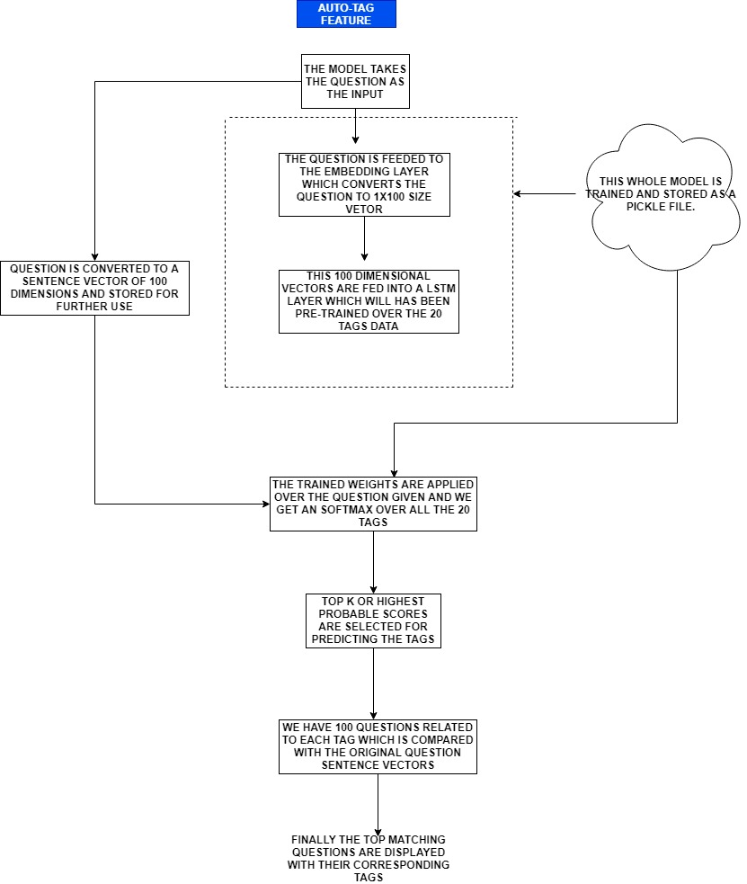
AUTO TAGGER WORKING.

Slide 6
Tech stack
Python
Nodejs
Javascript
Web Scraping
NLP Toolkits
Glove Embeddings 100 dimensional
Keras
Pandas
Sklearn
HTML
CSS
Bootstrap
Jquery

Slide 7
Example question-What is node?
Tags predicted -
As we can see that with scarcity and sparsity of this dataset we were still able to identify the tags with a good accuracy and the topics also seems relayed like-
angularjs - 12.8%
c# - 9.1%
php - 7.83%
jquery - 7.62%
Further improvement to the AI part-For Auto-Tagger we are currently reading only queries but we can also read the comments from the query and use that part to enhance our capability to enhance.
Even we have showed a demo on a very small dataset which can be increased to a great extent on increasing the dataset.

